Slide 1
Customer Ticketing Portal

Slide 2
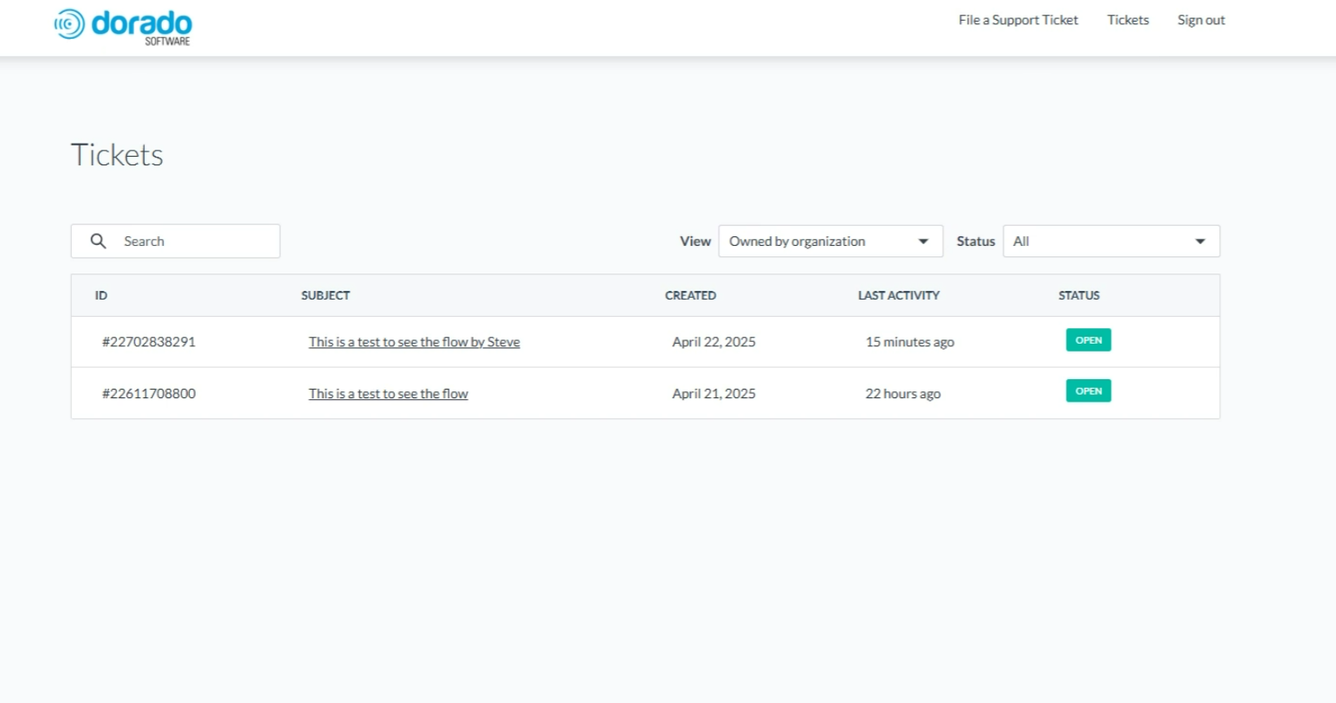
Ticketing Portal: Access
Customer designates the employees they would like to have access
  Must have an email address with your company domain
  They will receive an email invite to sign up – this comes from Hubspot.com (check spam)
  Users will Create their own unique login information
Portal Link: https://support.doradosoftware.com/customerportal

Slide 3
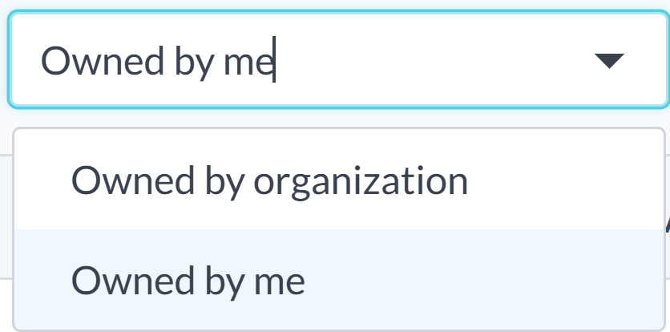
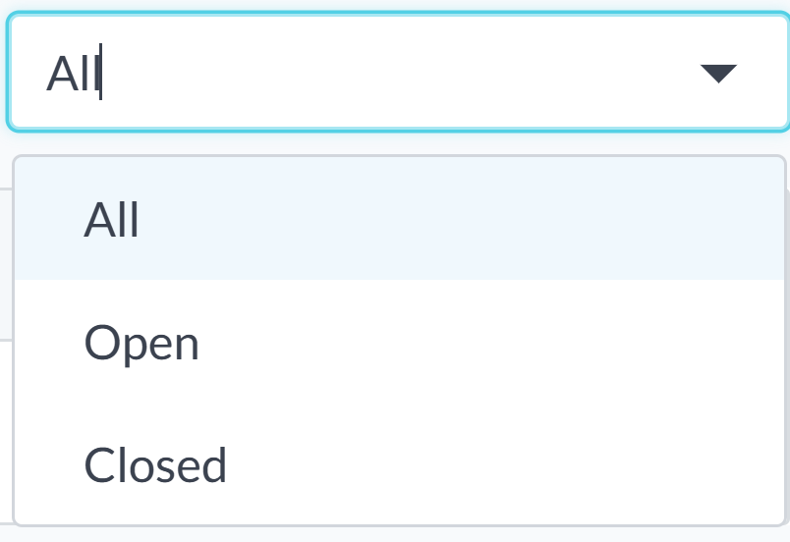
Ticketing Dashboard
Filter ticket view by ownership and/or status.

Slide 4
Ticketing Dashboard
Click here to file a ticket.

Slide 5
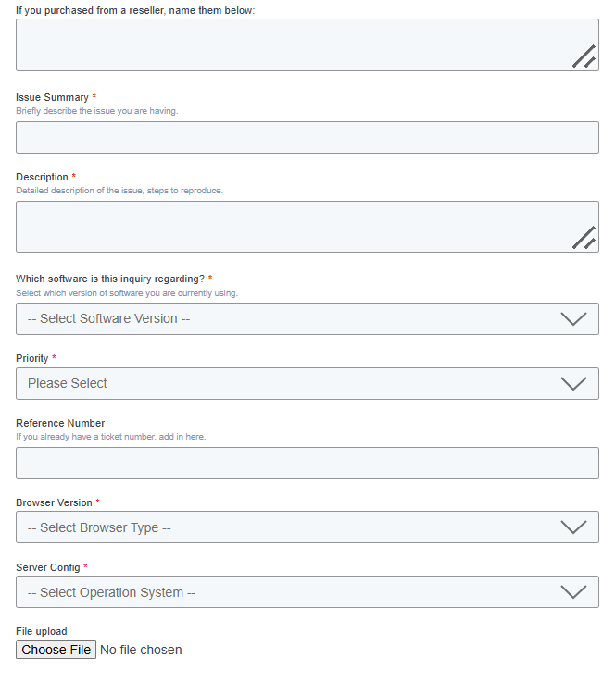
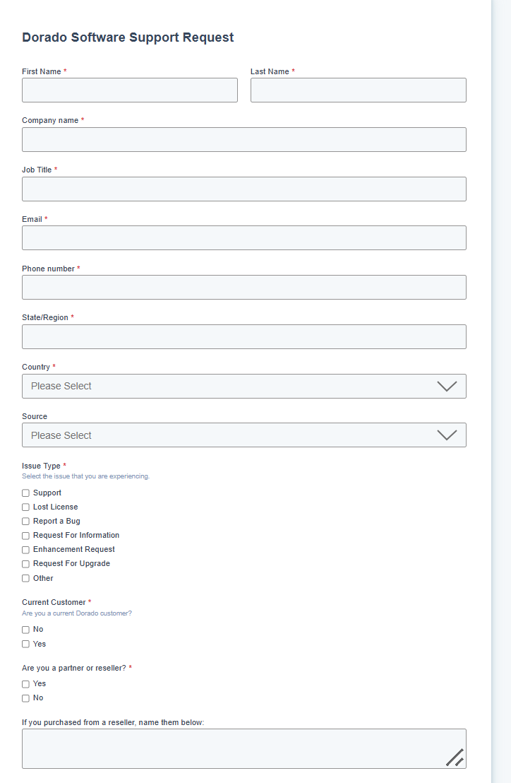
Submit Ticket

Slide 6
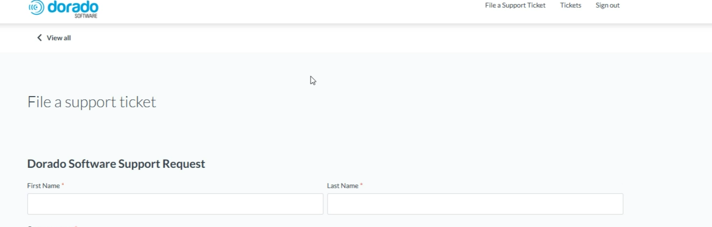
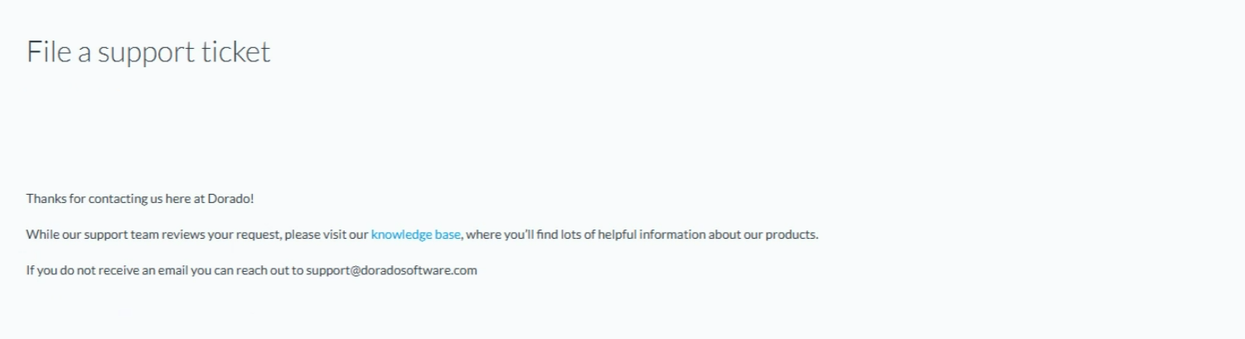
Ticket Submitted
Click to get back to ticket dashboard.

